Slide 1
IO Port Configuration Example
Embedded Software Essentials

Slide 2
Peripherals [S1a]
Peripherals: External to CPU specialized support hardware
Similar process to configure peripherals
Pointers
Memory Reads/Writes
Use of Bit Manipulation
Microcontroller
Flash
CPU
Registers
SRAM
Peripherals
Registers

Slide 3
Peripherals [S1b]
Peripherals: External to CPU specialized support hardware
Similar process to configure peripherals
Pointers
Memory Reads/Writes
Use of Bit Manipulation
GPIO – General Purpose Input/Output
Microcontroller
Flash
CPU
Registers
SRAM
Peripherals
GPIO
Registers
Registers
LED

Slide 4
Input Output Systems [S2a]
Input/Output: method to get data in/out of microcontroller
GIO
IO
GPIO (General Purpose IO)
Microcontroller
CPU
Peripherals
SPI
UART
ADC
Registers
Registers
Registers
GPIO Port
Registers

Slide 5
Input Output Systems [S2b]
Input/Output: method to get data in/out of microcontroller
GIO
IO
GPIO (General Purpose IO)
Microcontroller
CPU
Peripherals
SPI
UART
ADC
Registers
Registers
Registers
GPIO Port
Registers
Multiple Pins
External Circuits

Slide 6
Input Output Systems [S2c]
Input/Output: method to get data in/out of microcontroller
GIO
IO
GPIO (General Purpose IO)
Pin – physical connection to microcontroller
Port – combination of pins
Microcontroller
CPU
Peripherals
SPI
UART
ADC
Registers
Registers
Registers
GPIO Port
Registers
Multiple Pins
External Circuits

Slide 7
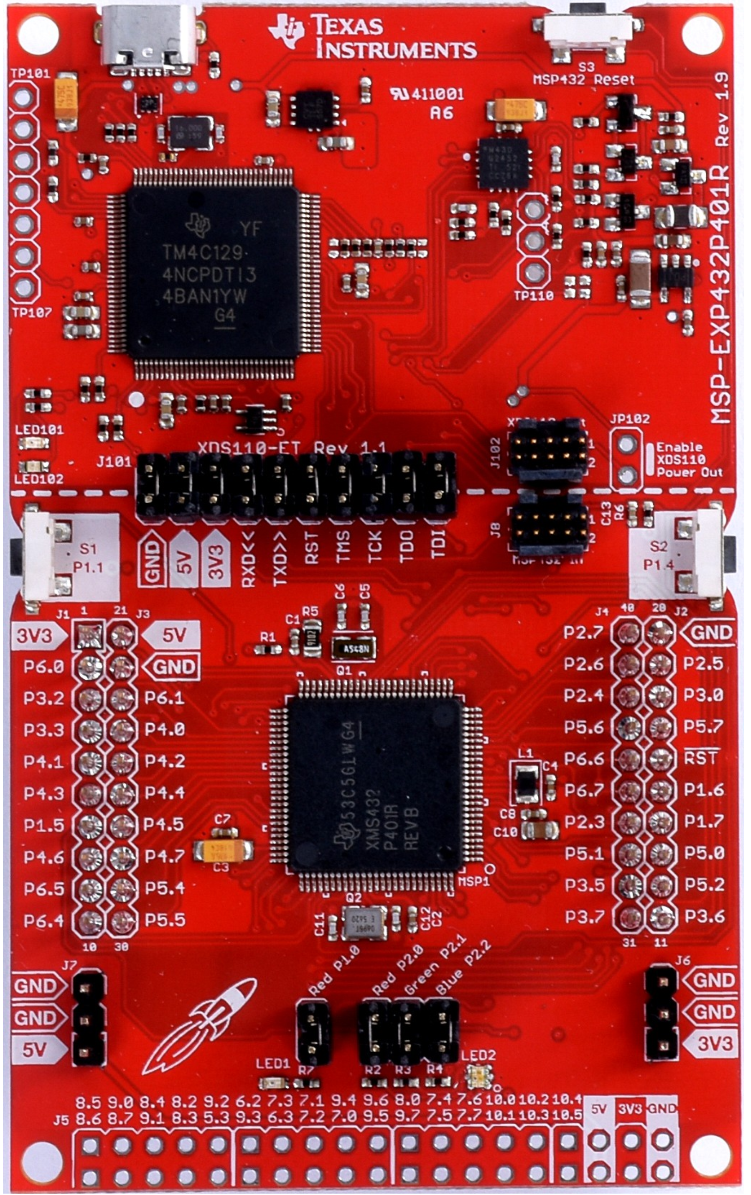
MSP432 Ports [S3a]
Notes:
http://www.ti.com/lit/ug/slau597c/slau597c.pdf

Slide 8
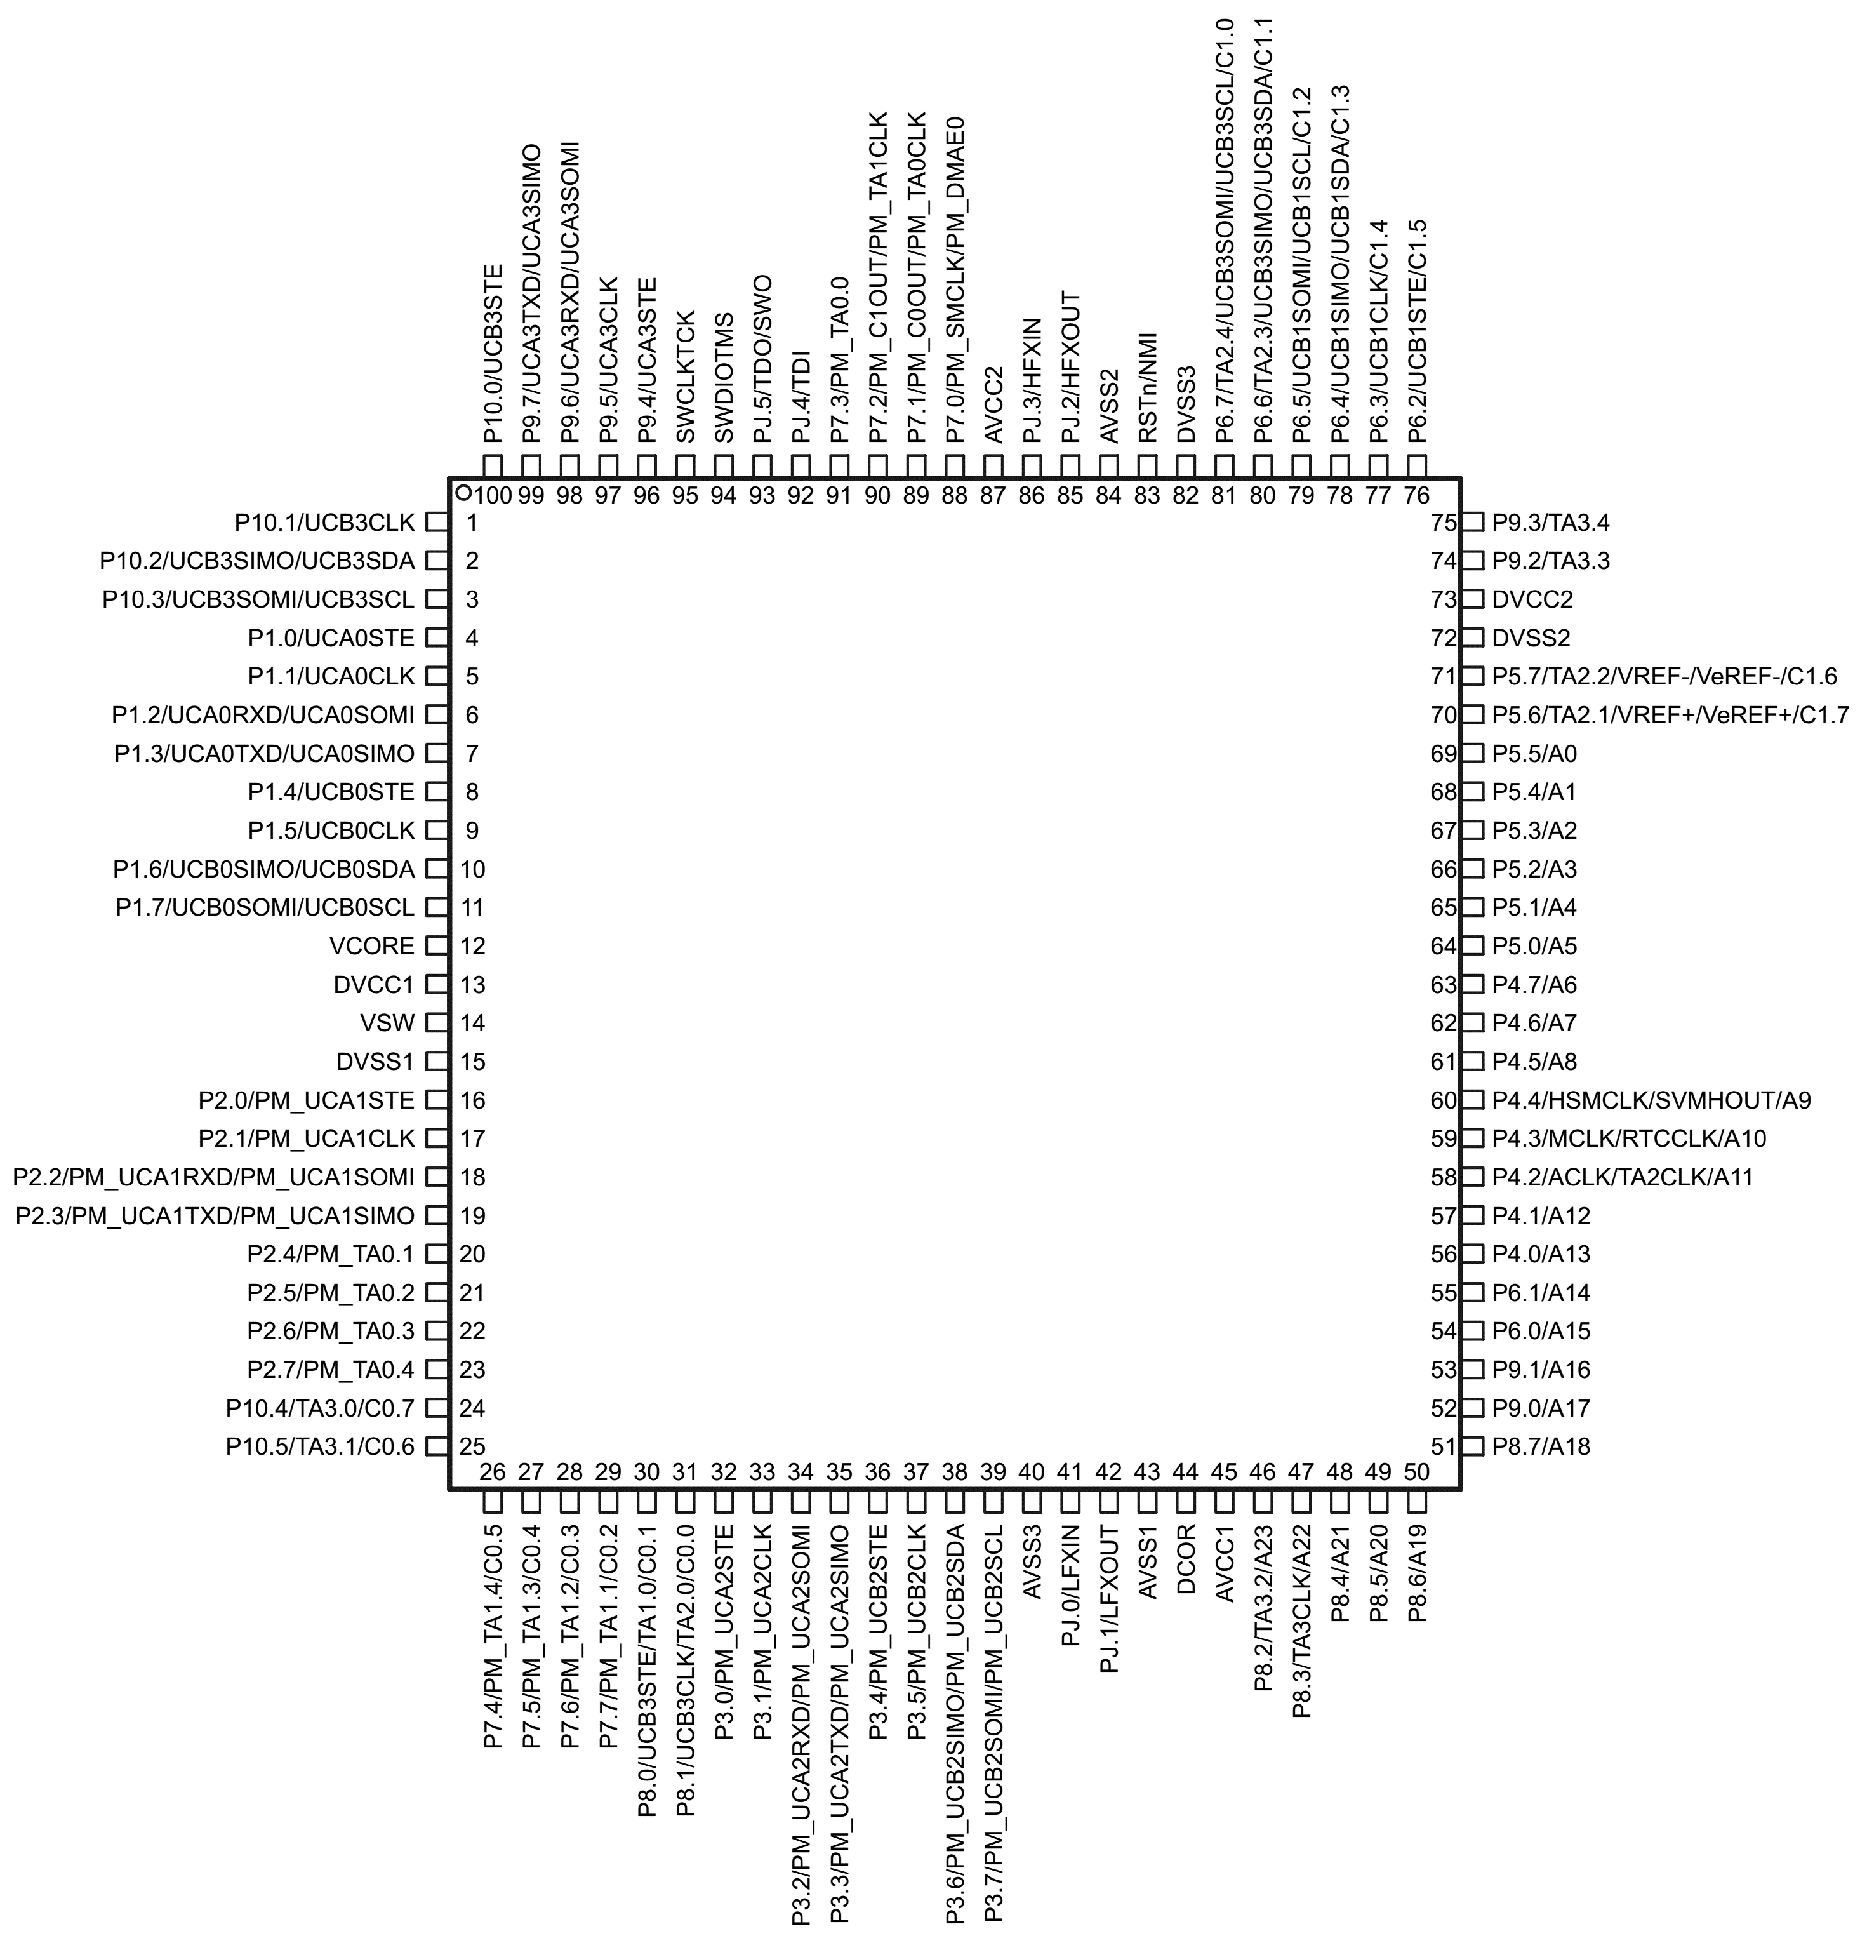
MSP432 Ports [S3b]
10 Ports
Notes:
http://www.ti.com/lit/ug/slau597c/slau597c.pdf

Slide 9
MSP432 Ports [S3c]
10 Ports
Port 1 – 8 Pins
GPIO / Primary / Secondary
Port 1 Pin 0 = P1.0
Primary Mode = SPI Chip Select
Port 1 Pin 7 = P1.7
Primary Mode = SPI Slave-Out-Master-In Data (UCB0SOMI)
Secondary Mode = I²C Clock (UCB0SCL)
Notes:
http://www.ti.com/lit/ug/slau597c/slau597c.pdf

Slide 10
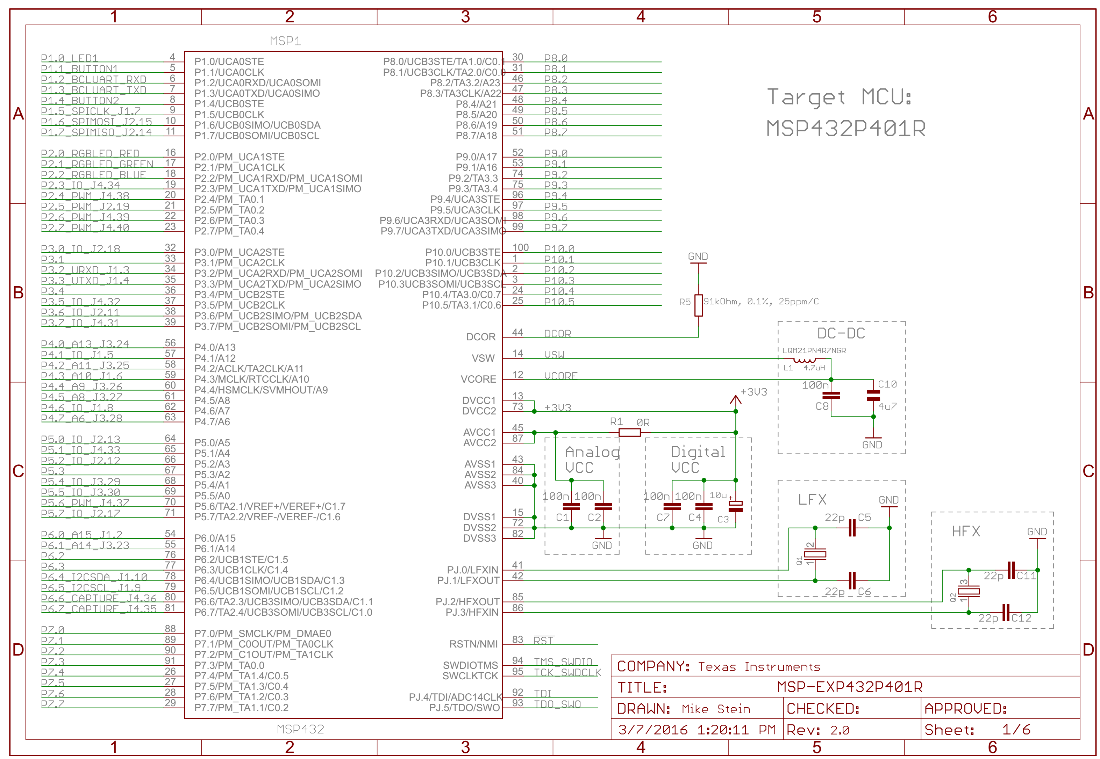
MSP432 Ports [S4a]
Notes:
http://www.ti.com/lit/ug/slau597c/slau597c.pdf

Slide 11
MSP432 Ports [S4b]
LaunchPad Schematic: Microcontroller Connections
P1.0 Red LED Circuit
Notes:
http://www.ti.com/lit/ug/slau597c/slau597c.pdf

Slide 12
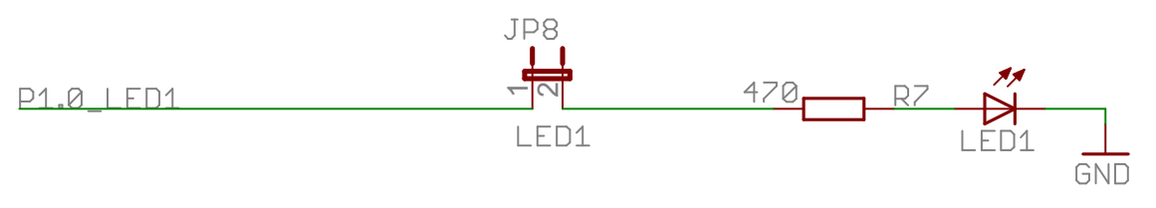
MSP432 Ports [S4a]
P1.0 Red LED Circuit
LED Schematic for P1.0
Notes:
http://www.ti.com/lit/ug/slau597c/slau597c.pdf

Slide 13
MSP432 Launchpad Schematic [S5a]
RED LED Schematic
Launchpad Schematic: MSP432 Pinout
Notes:
http://www.ti.com/lit/ug/slau597c/slau597c.pdf

Slide 14
MSP432 Launchpad Schematic [S5b]
MSP432 Port 1
Schematic Label for P1.0: P1.0_LED1
RED LED Schematic
Launchpad Schematic: MSP432 Pinout
Notes:
http://www.ti.com/lit/ug/slau597c/slau597c.pdf
http://www.ti.com/lit/ds/symlink/msp432p401m.pdf

Slide 15
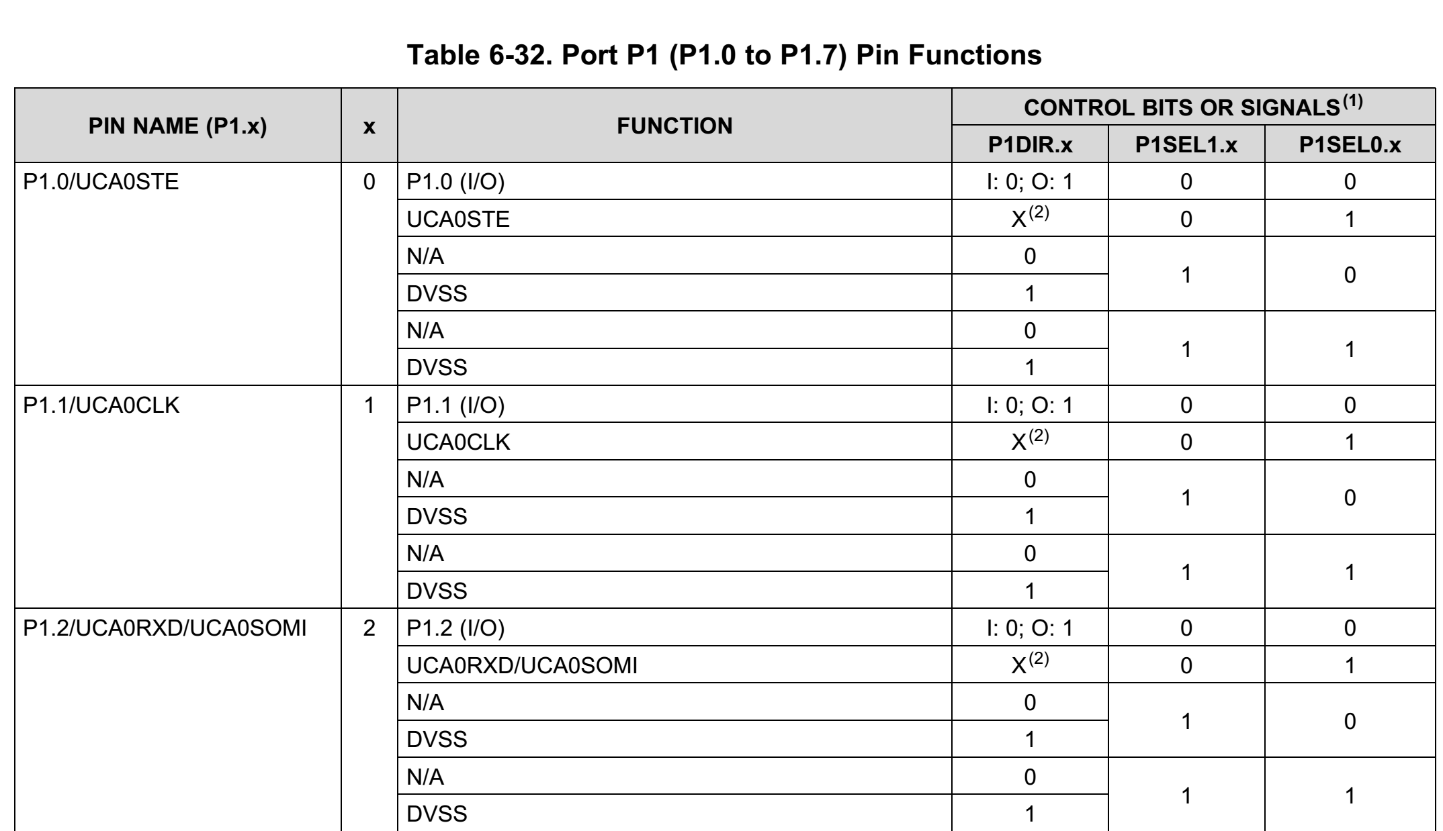
MSP432 Launchpad Schematic [S5c]
MSP432 Pinout Port 1
MSP432 Pin Descriptions
Pin Number
Pin Modes
Notes:
http://www.ti.com/lit/ug/slau597c/slau597c.pdf
http://www.ti.com/lit/ds/symlink/msp432p401m.pdf

Slide 16
MSP432 Launchpad Schematic [S5d]
MSP432 Pinout Port 1
MSP432 Pin Descriptions
Pin Number
Pin Modes
Port P1Sel0.x /P1Sel1.x registers Select Mode for each Pin in Port
Notes:
http://www.ti.com/lit/ug/slau597c/slau597c.pdf
http://www.ti.com/lit/ds/symlink/msp432p401m.pdf

Slide 17
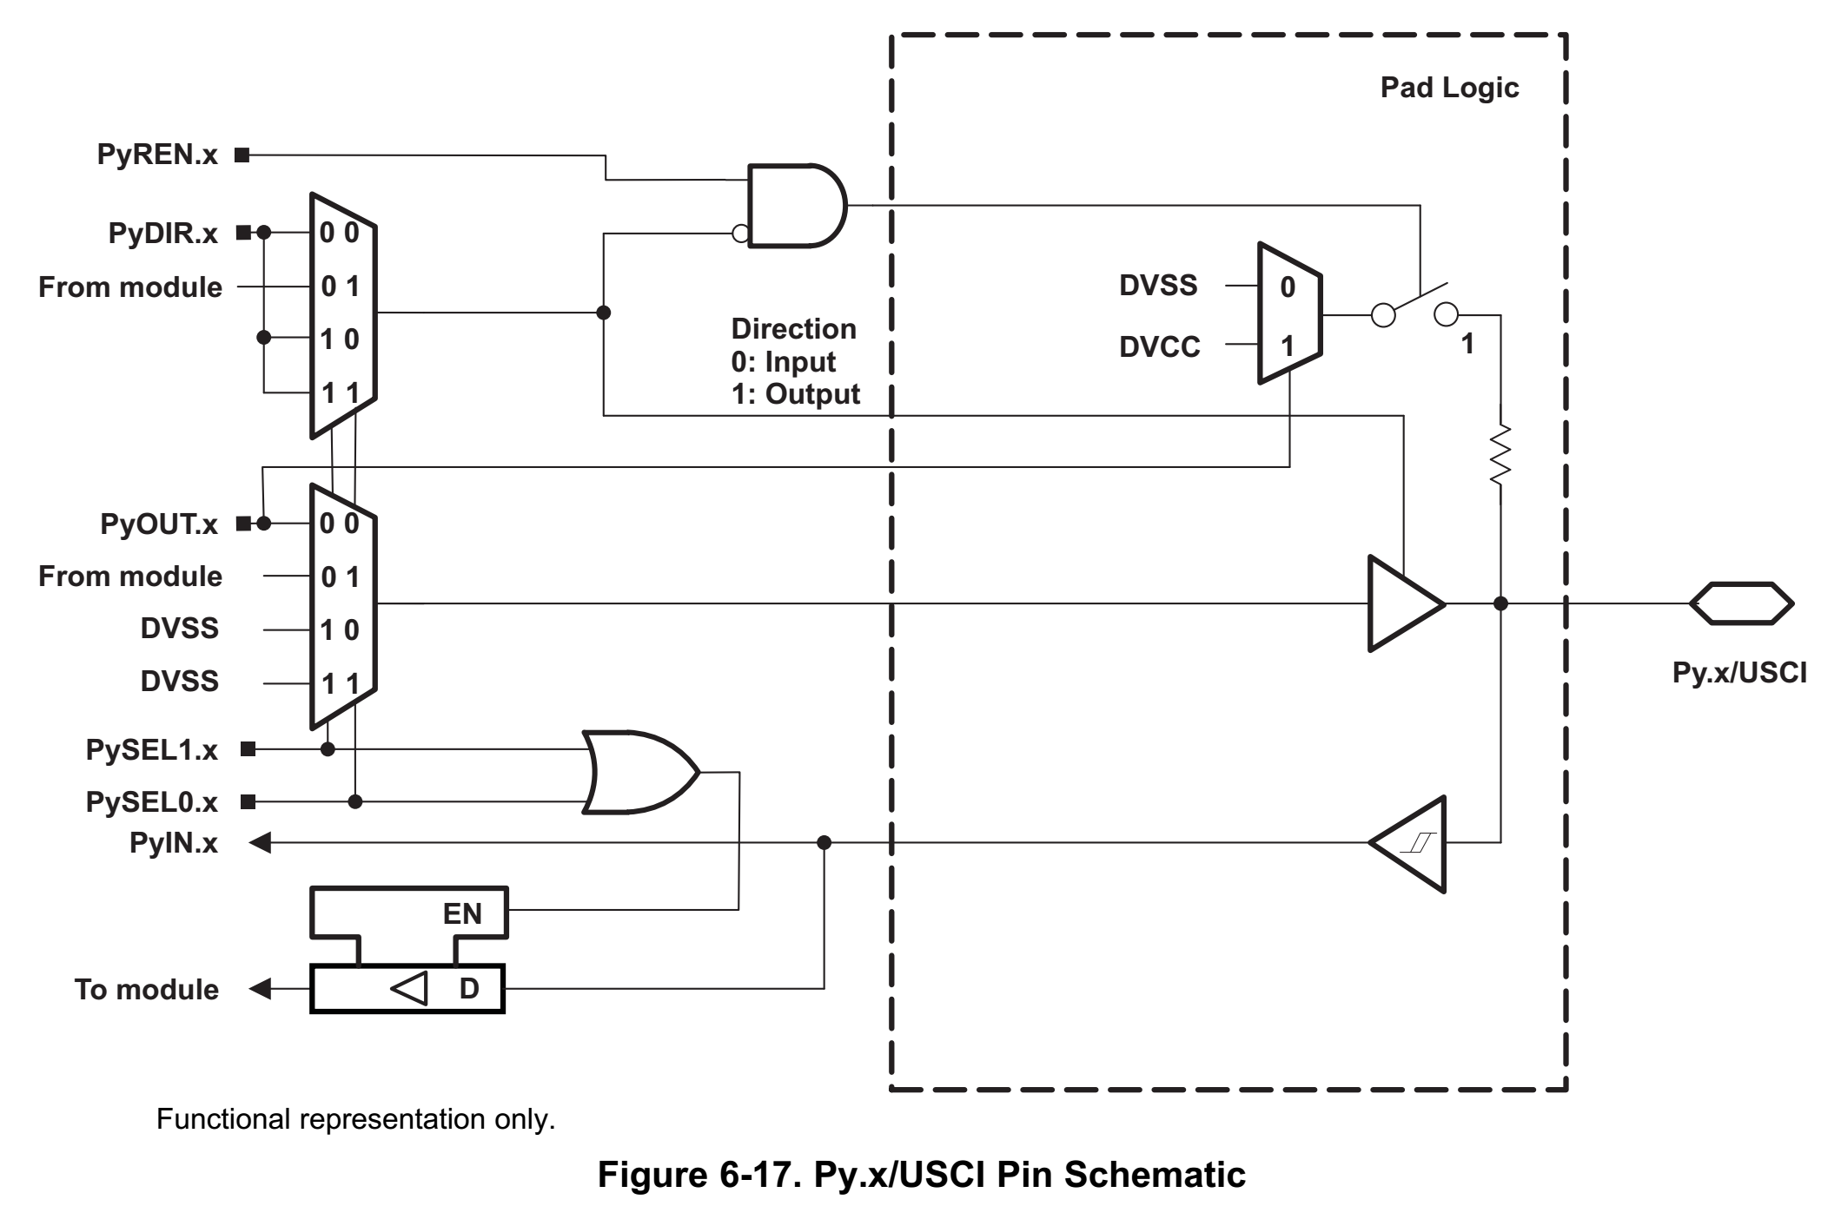
Configuring the LED [S6a]
To configure LED on P1.0¹
¹Also Required to Set Pin to I/O Mode (P1SELx). This is set by default
Notes:
http://www.ti.com/lit/ds/symlink/msp432p401m.pdf

Slide 18
Configuring the LED [S6b]
To configure LED on P1.0¹
Set direction to output (P1DIR)
¹Also Required to Set Pin to I/O Mode (P1SELx). This is set by default
Notes:
http://www.ti.com/lit/ds/symlink/msp432p401m.pdf

Slide 19
Configuring the LED [S6c]
To configure LED on P1.0¹
Set direction to output (P1DIR)
Set P1.0 output to high (P1OUT)
¹Also Required to Set Pin to I/O Mode (P1SELx). This is set by default
Notes:
http://www.ti.com/lit/ds/symlink/msp432p401m.pdf

Slide 20
Configuring the LED [S6d]
To configure LED on P1.0¹
Set direction to output (P1DIR)
Set P1.0 output to high (P1OUT)
To turn on LED, P1.0_LED1 voltage needs to be a Logical HIGH → VCC(3.3v)
¹Also Required to Set Pin to I/O Mode (P1SELx). This is set by default
Notes:
http://www.ti.com/lit/ds/symlink/msp432p401m.pdf

Slide 21
Configuring the LED [S6e]
To configure LED on P1.0¹
Set direction to output (P1DIR)
Set P1.0 output to high (P1OUT)
To turn on LED, P1.0_LED1 voltage needs to be a Logical HIGH → VCC(3.3v)
¹Also Required to Set Pin to I/O Mode (P1SELx). This is set by default
Notes:
http://www.ti.com/lit/ds/symlink/msp432p401m.pdf

Slide 22
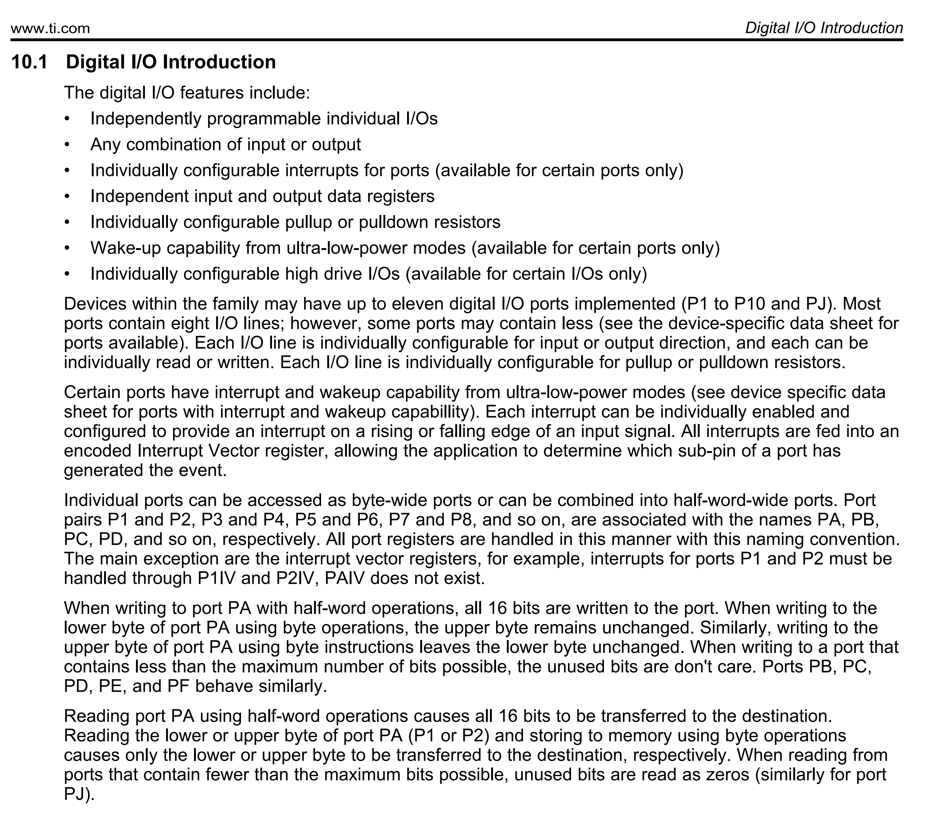
Configuring IO Port [S7a]
Technical reference manual provides configuration steps
Digital IO has own section
Important to read through this

Slide 23
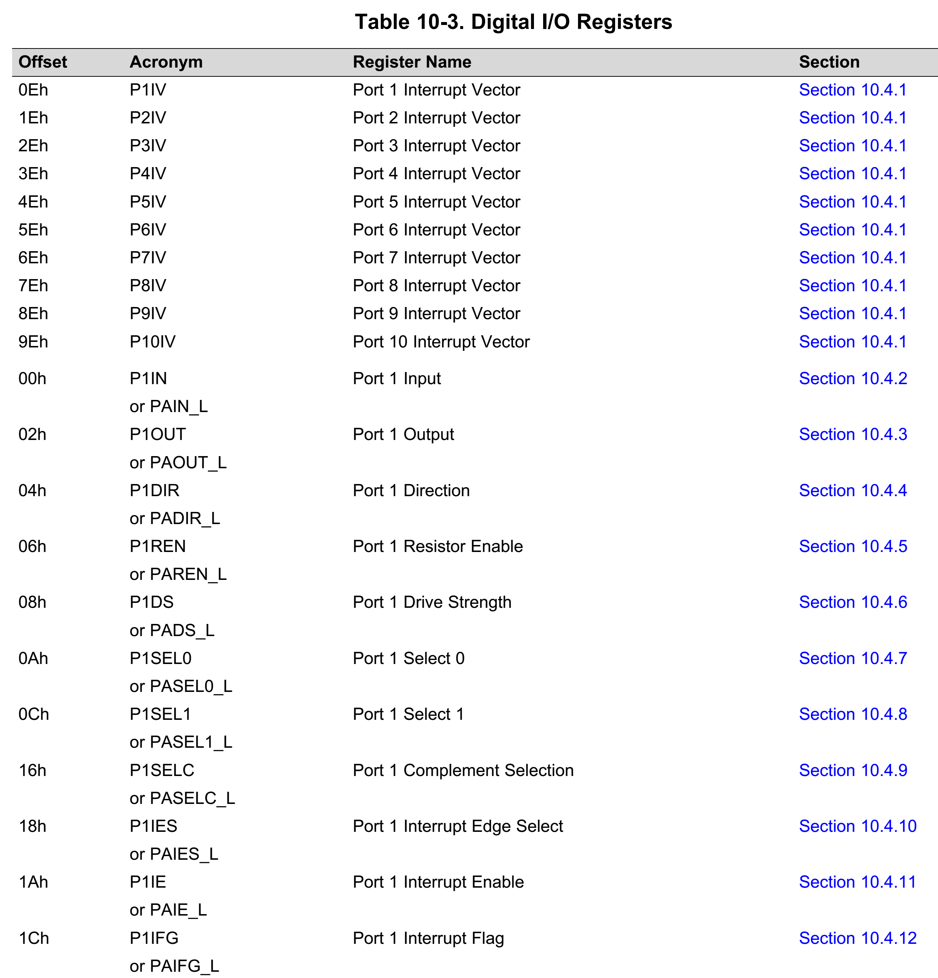
Configuring IO Port [S7b]
Two important registers
IO Direction Register (P1DIR)
IO Output Register (P1OUT)
Register section provides the software configuration steps using Bit Manipulation

Slide 24
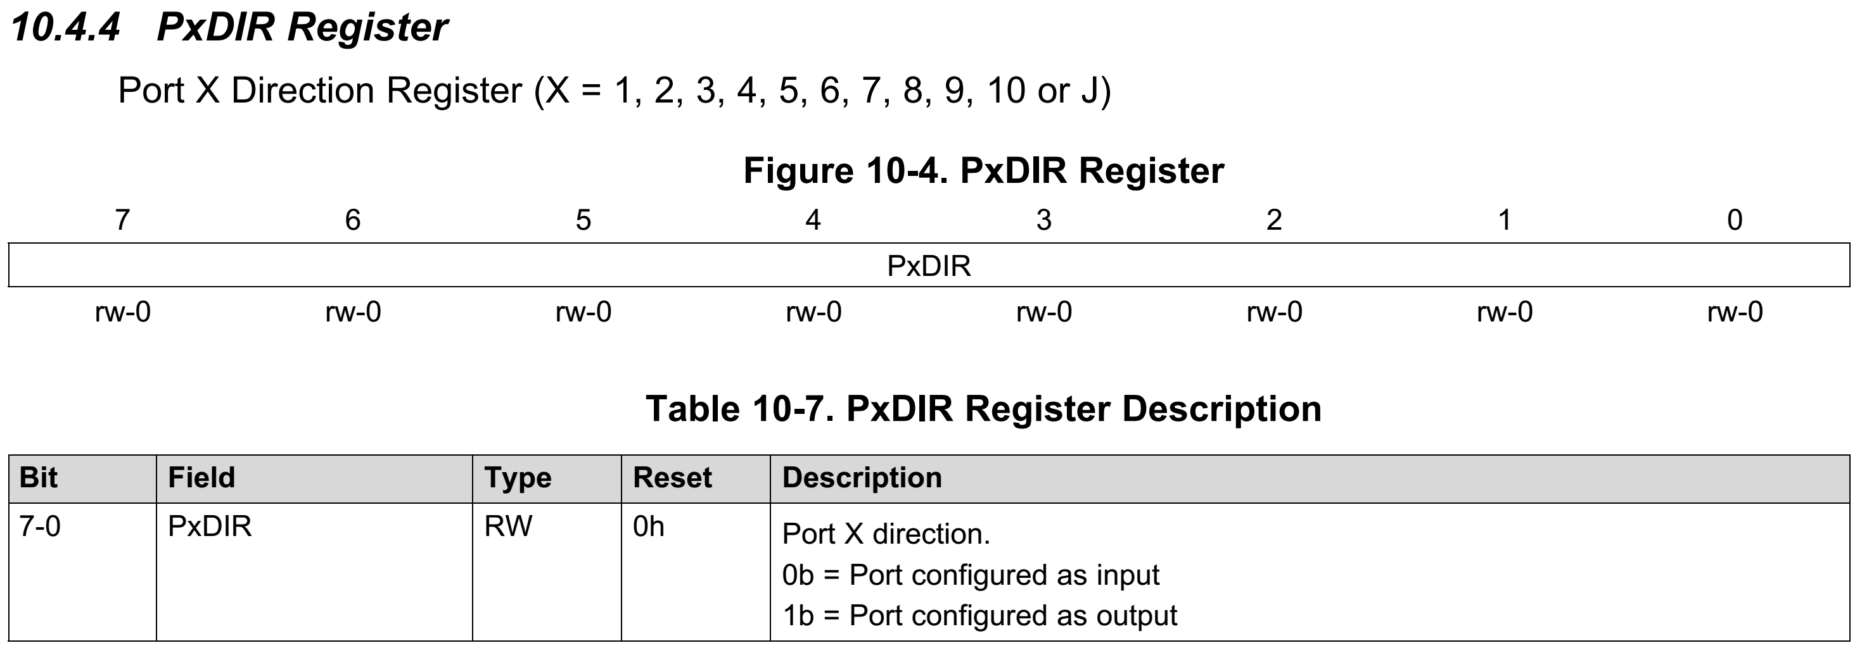
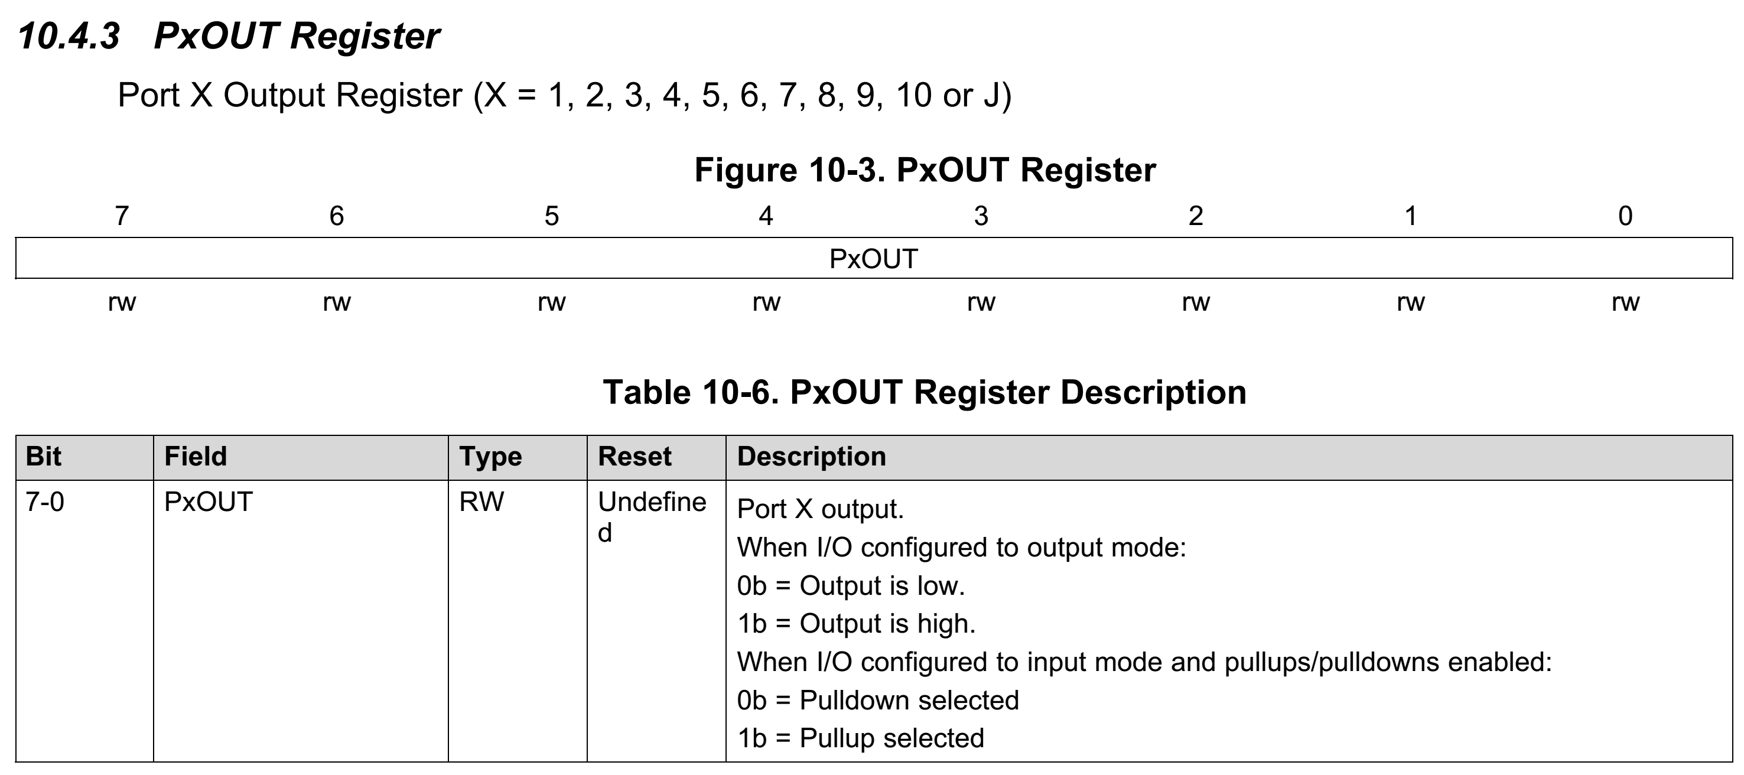
Configuring IO Port [S7c]
Two important registers
IO Direction Register (PxDIR)
IO Output Register (PxOUT)
PxOUT, PxDIR
x = Port Number
Examples:
P2OUT
P1DIR

Slide 25
P1DIR Register [S8a]
Port Direction Register sets pin to:
0: an input
1: an output

Slide 26
P1DIR Register [S8b]
Port Direction Register sets pin to:
0: an input
1: an output
/* Configure P1.0 output */
P1->DIR |= BIT0;

Slide 27
P1DIR Register [S8a]
Port Direction Register sets pin to:
0: an input
1: an output
/* Configure P1.0 output */
P1->DIR |= BIT0;
rw-0: Bit is Read/Write &
defaults to 0

Slide 28
P1OUT Register [S9a]
Port Output Register sets output to:
0: Output set to LOW (GND)
1: Output set to HIGH (VCC)

Slide 29
P1OUT Register [S9b]
Port Output Register sets output to:
0: Output set to LOW (GND)
1: Output set to HIGH (VCC)
/* Configure P1.0 output */
P1->DIR |= BIT0;
/* Set P1.0 HIGH */
P1->OUT |= BIT0;

